Slide 1

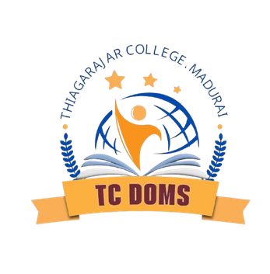

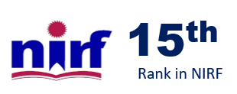

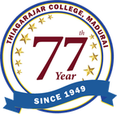

Thiagarajar College
Madurai, Tamil Nadu 625 009
20ᵗʰ
RANK
DABUR INDIA LTD
NAME:
COMPANY NAME: DABUR INDIA LTD GUIDED BY: DR. T. JOEL GNANAPRAKASH
Celebrate Life

Slide 2
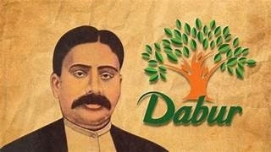
ABOUT THE COMPANY
Founded in 1884 by Dr. S.K. Burman, Dabur is one of India’s oldest and most trusted FMCG companies.
Mission
Headquartered in Ghaziabad, Uttar Pradesh.
Deliver high-quality Ayurvedic and natural products.
Known for its strong heritage in Ayurveda, offering products across Health Care, Personal Care, Home Care, and Foods.
Expand globally while deepening market presence.
A global presence with products sold in 120+ countries.
Vision
Promote consumer health, sustainability, and eco-friendly practices.
“Dedicated to the health & well-being of every household.”

Slide 3

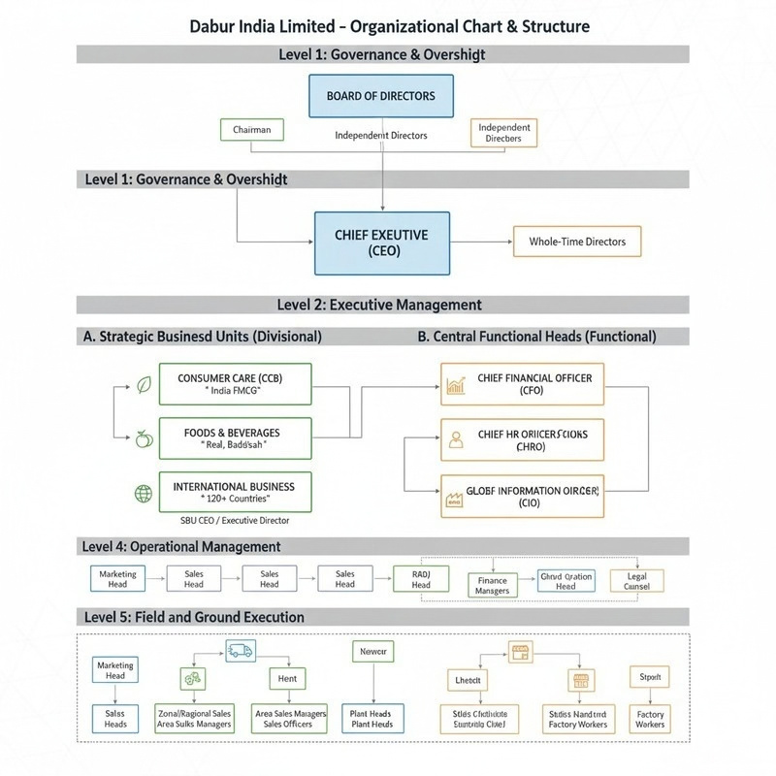
Hybrid Structure Model
Dabur follows a Hybrid Organizational Structure that combines Functional, Divisional, and Geographical systems for maximum efficiency. Functional Structure (Core Strategy)
Product-Based Divisional Strategy To manage a large FMCG portfolio, Dabur divides operations into product divisions:
Company is primarily organized by key functions: Marketing
Finance
Human Resources
Operations / Supply Chain
R&D
Sales
Each function has its own leadership for specialized decision-making.
Geographic Expansion Structure
Healthcare Division Home & Personal Care Division
Foods & Beverages Division
Ayurvedic OTC Division This helps teams focus on category-specific growth and innovation.
For international operations, Dabur uses region- based structure:
India Business
Middle East
Africa
Europe & North America
Each region manages its own marketing, sales, and supply chain strategies.

Slide 4
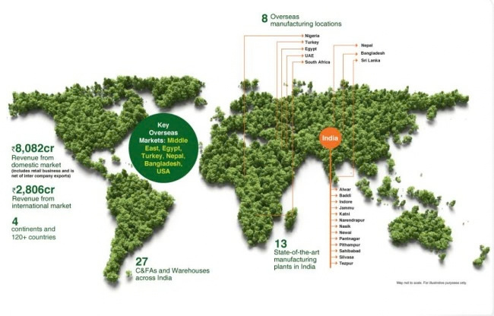

Production:
Global Footprint
Resilient & Global Dabur
operates a highly diversified manufacturing network across 9 countries, ensuring its products reach consumers in over 120 countries.
13 state-of-the-art plants in India.
8 overseas manufacturing locations.
8,082 cr revenue from domestic market. 2,806 cr revenue from international market.

Slide 5
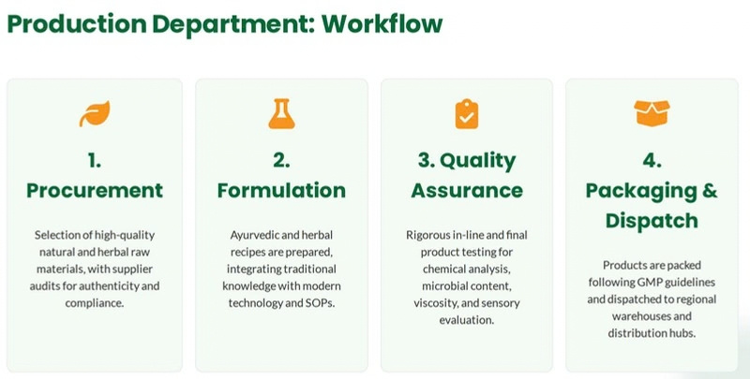

Slide 6
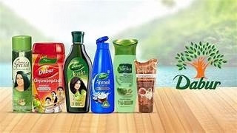
MARKETING DEPARTMENT
Dabur follows long-term customer-centric marketing that highlights Ayurveda, trust, and family values.
Target Audience includes middle-class families, rural consumers, youth, health-conscious customers & global Ayurvedicbelievers.
Brand management :
Focus on strengthening in key brands like vakita, real are differentiate them in a competitive market
Market research :
Conducts studies with Accenture to understand consumers perception market trends and inform strategy.
4Ps
Product:-
Portfolio: Dabur offers a diverse portfolio of products, including healthcare items (supplements, digestives, cough/cold remedies), hair care, oral care, skin care, and food and beverages like Real Juice.
clear space
Natural and Ayurvedic focus: A core part of its strategy is emphasizing products made with natural ingredients and based on traditional Ayurvedic principles.
Value-added offerings: Products like Vatika Hair Oil are positioned as value-added, using specific natural ingredients like henna, amla, and lemon in pure coconut oil.
Quality assurance: Dabur's in-house research labs and the Dabur Research Foundation are used to ensure high- quality products that meet international standards.
Price:-
Variable pricing: The company uses a varied pricing strategy, with products ranging from mass-market to premium. For instance, some products target different income classes.
Premium pricing example: In some cases, like Vatika Hair Oil, Dabur has successfully used a premium pricing strategy to achieve a significant market share, even when compared to lower-priced competitors.

Slide 7
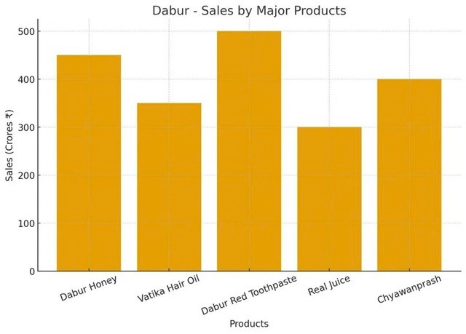
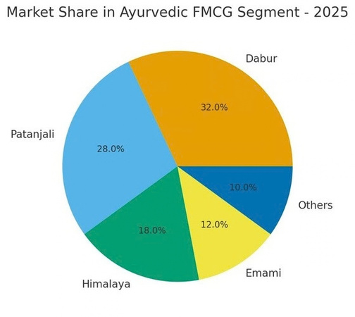
Place (Distribution):-
Extensive network: Dabur has one of the largest distribution networks in India, covering approximately 6 million retail outlets in both rural and urban areas across over 100 countries.
Multi-channel approach: The company distributes through a network of manufacturers, wholesalers, and retailers, as well as through e-commerce platforms.
Promotion:-
Celebrity endorsements: A key strategy is using famous celebrities and sports figures to endorse its products, such as Amitabh Bachchan for Chyawanprash and Hajmola, and Sonakshi Sinha for Vatika.
Traditional media: Dabur runs advertisements on television and in newspapers, and uses hoardings at retail outlets and supermarkets.
Digital marketing: The company actively promotes its products through social media platforms like Facebook, Instagram, and Twitter, and uses platforms like YouTube for campaigns.
Corporate social responsibility campaigns: Dabur also engages in promotional campaigns that align with social causes, such as "Make your winter healthy with Dabur Chyawanprash" or joining hands with government initiatives.
Competition: HUL, Marico, Patanjali, Emami & Himalaya remain strong competitors in personal care, oral care & wellness.

Slide 8
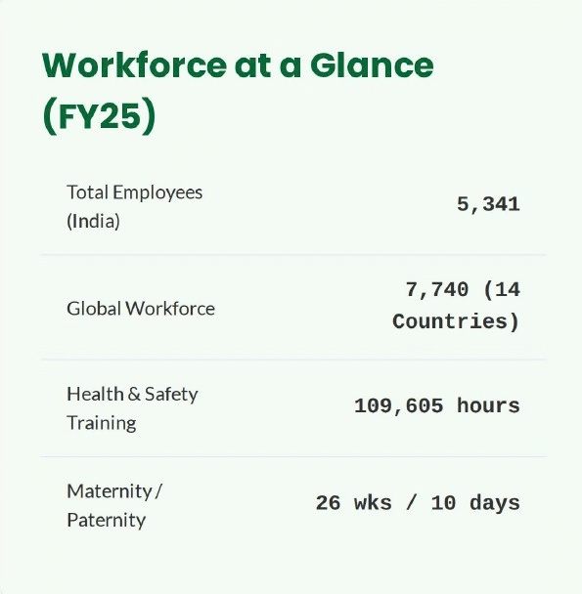

HR DEPARTMENT OVERVIEW –
Dabur India Ltd
• Strategic Role:
Drives a performance-driven, employee-centric culture supporting Dabur’s global FMCG operations across 120+ countries.
• Structure:
CHRO → HR Business Partners, Talent Acquisition, L&D, Payroll, IR, Engagement, HR Analytics.
• Key Functions:
Recruitment & selection, training & capability building, performance management (KPI/MBO), compensation & benefits, labour law compliance, employee relations, welfare, and HRIS.
• Major HR Practices:
Campus & lateral hiring, annual TNA, leadership development, 360° feedback, digitized payroll, and data-driven HR dashboards.
• Employee Welfare & Culture:
Strong engagement programs, recognition schemes, health & safety initiatives, wellness activities, and value-driven Ayurveda-based culture.
• Technology Use:
HRMS for payroll/attendance, e-learning platforms, digital recruitment, mobile ESS, HR analytics for forecasting.
• Current HR Focus Areas:
Retention of high-performing sales staff, skill-gap bridging, automation of HR processes, and preparing future leaders.

Slide 9
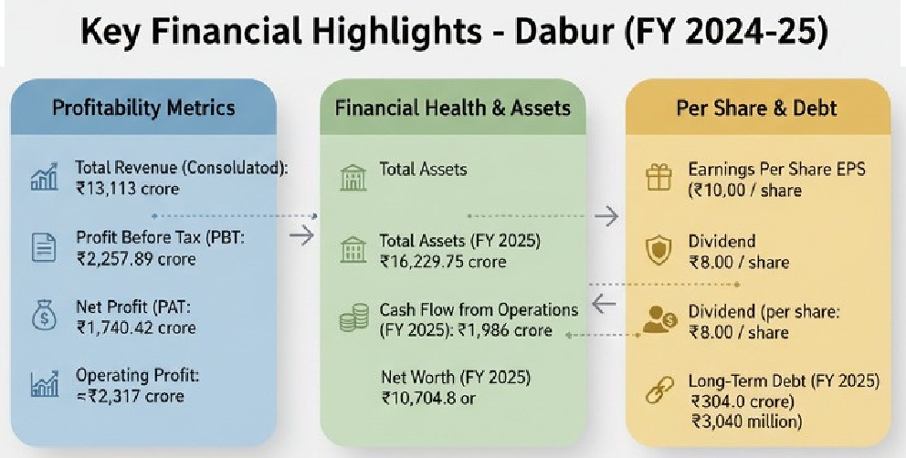
FINANCE DEPARTMENT OVERVIEW – DABUR LTD
1. STEADY REVENUE GROWTH: CONSOLIDATED REVENUE GREW FROM ₹9,887 CRORE IN FY21 TO ₹13,113 CRORE IN FY25, DEMONSTRATING CONSISTENT TOP-LINE EXPANSION.
2. STABLE BUT PRESSURED PROFITABILITY: NET PROFIT REMAINED IN THE RANGE OF ~₹1,700-₹1,843 CRORE OVER THE LAST FIVE YEARS, WITH A SLIGHT MARGIN CONTRACTION TO 13.9% IN FY25.
3. STRONG FINANCIAL HEALTH: THE COMPANY HAS A ROBUST CURRENT RATIO OF 1.51 AND AN EXTREMELY LOW DEBT-EQUITY RATIO OF -0.03, INDICATING HIGH LIQUIDITY AND MINIMAL LEVERAGE.
4. HEALTHY CASH FLOW GENERATION: THE COMPANY MAINTAINS STRONG OPERATING CASH FLOW (₹1,986 CRORE IN FY25), WHICH ENSURES LIQUIDITY FOR OPERATIONS AND EXPANSION. REWARDING ITS INVESTORS.
5. SIGNIFICANT SHAREHOLDER RETURNS: DABUR PAID A DIVIDEND OF ₹8.007 PER SHARE IN FY25, WITH A TOTAL PAYOUT OF ₹1,418 CRORE,

Slide 10
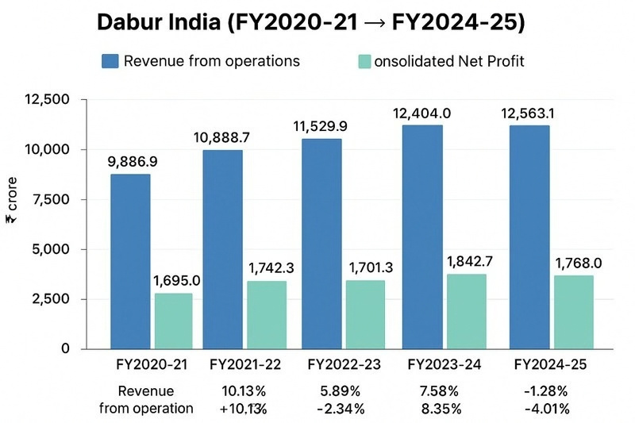
6. RISING COSTS ARE A CHALLENGE: THE COMPANY FACED PRESSURE FROM RISING DEPRECIATION (+11.7%) AND INTEREST COSTS (+31.7%), IMPACTING NET PROFIT.
7. HIGH MARKETING INVESTMENT: MARKETING SPENDS WERE HIGH AT ₹864.6 CRORE, IDENTIFIED AS AN AREA REQUIRING TIGHT CONTROL TO PROTECT PROFITABILITY.
8. AGGRESSIVE DEBT REDUCTION: DABUR SIGNIFICANTLY REDUCED ITS LONG-TERM DEBT BY 43%, BRINGING IT DOWN TO JUST ₹30.61 CRORE, MINIMIZING FINANCE COSTS.
9. SUBDUED OPERATING MARGIN: THE OPERATING PROFIT MARGIN WAS REPORTED AT -18.4%, A KEY AREA OF CONCERN THAT REQUIRES IMPROVEMENT.
10. STRATEGIC FOCUS ON AUTOMATION & RISK MANAGEMENT: RECOMMENDATIONS INCLUDE USING AI FOR FORECASTING, STRENGTHENING CREDIT CONTROL, AND ENHANCING FOREX HEDGING FOR ITS 120+ COUNTRY OPERATIONS.

Slide 11
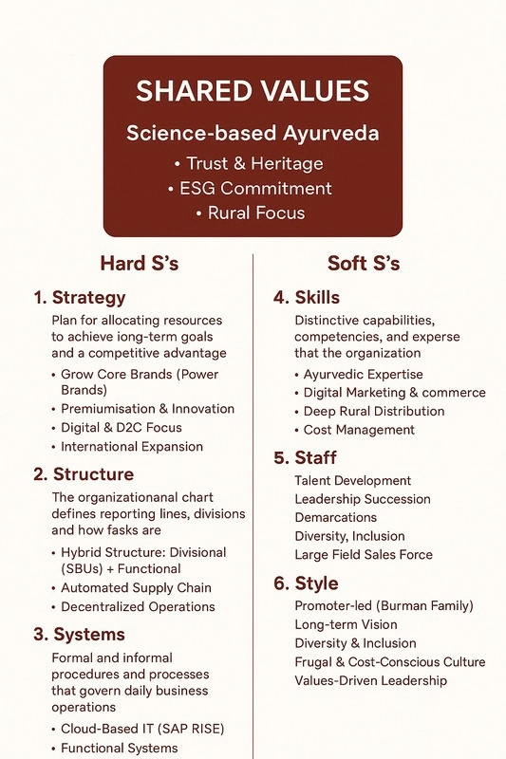
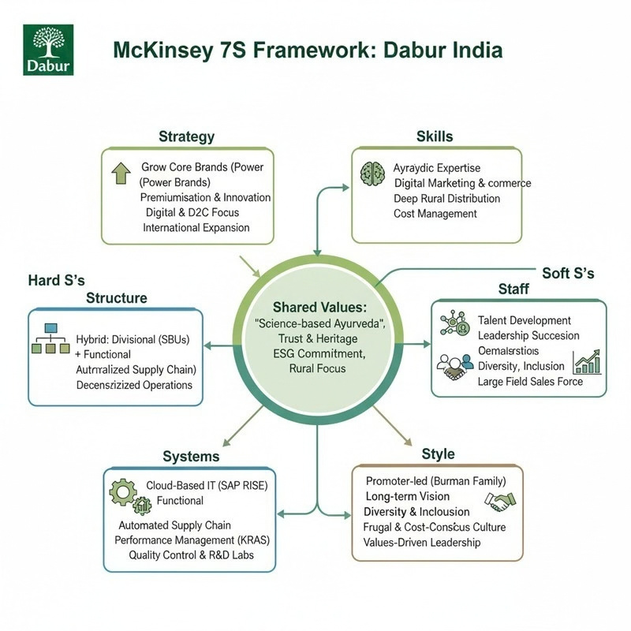

Slide 12
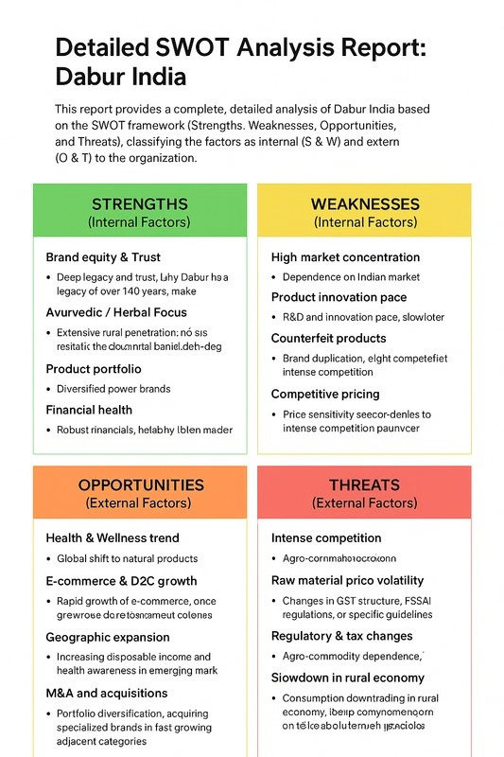
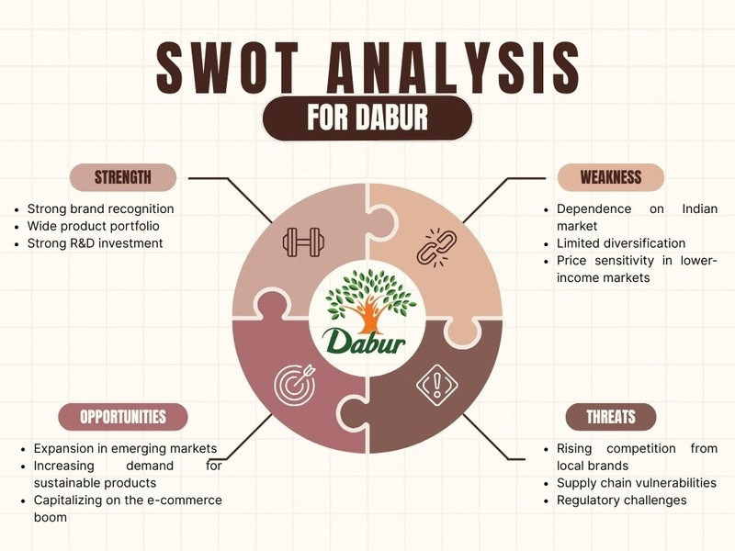

Slide 13
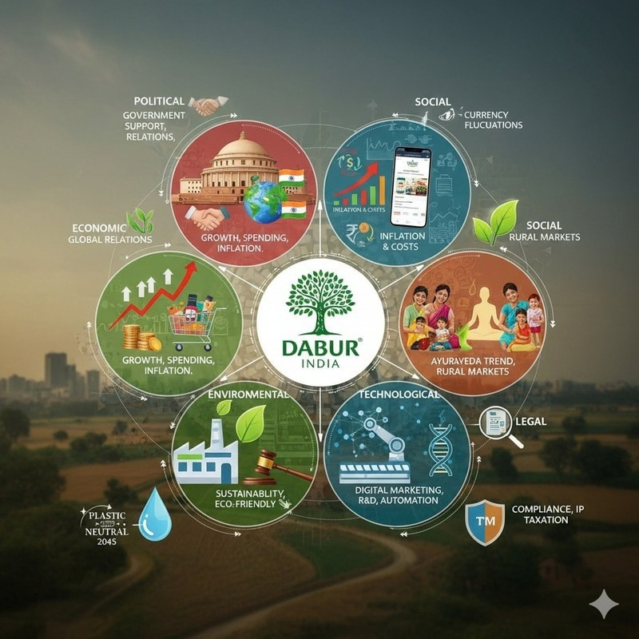
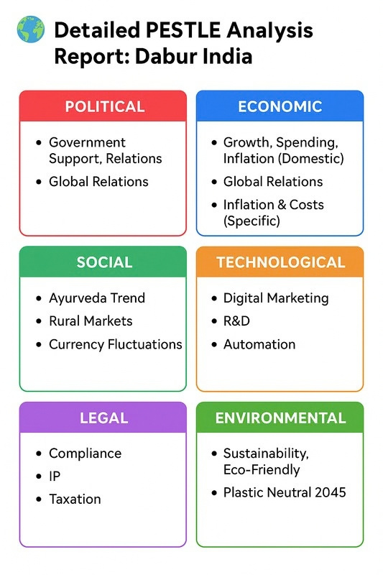
PESTLE ANALYSIS

Slide 14

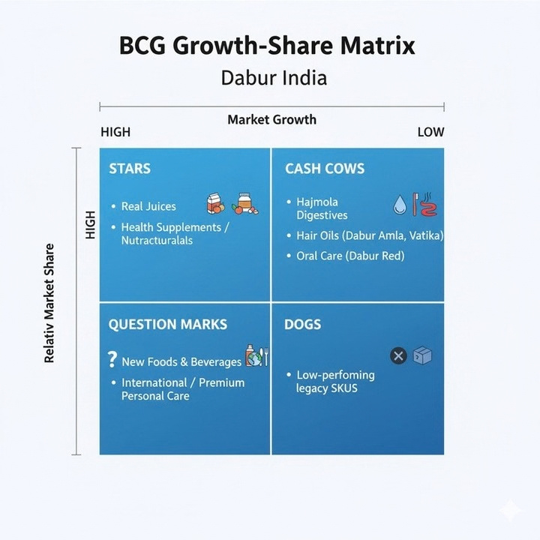
BCG matrix analysis
Quadrant
Product Lines
Characteristics
Strategy
⭐
Real Juices, Health
Supplements / Nutraceuticals
High Market Share + High
Market Growth
Invest to grow; strengthen leadership; future Cash Cows
Stars
Hajmola Digestives, Hair Oils (Amla/Vatika), Oral Care (Dabur Red)
High Market Share + Low Market Growth
Harvest/hold; maximize profit; fund Stars & promising Question Marks
🐄
Cash Cows
New Foods & Beverages, International/Premium Personal Care
Low Market Share + High Market Growth
Selectively invest in high- potential ones; divest the weak
❓
Question Marks
🐕
Low-Performing Legacy SKUs
Low Market Share + Low Market Growth
Divest or discontinue; minimize cost drain
Dogs

Slide 15
Conclusion:
Dabur India Ltd. stands as one of the most financially stable and strategically resilient FMCG companies in India, driven by its strong foundation in Ayurveda and a diversified global presence. The company’s robust financial systems, including disciplined budgeting, low-debt capital structure, and high operating cash flows, showcase its capability to sustain long-term growth while minimizing risk. The Finance Department plays a critical role in enabling this stability through efficient planning, strict cost controls, transparent reporting, and effective working capital management.
Dabur’s strategic alignment across finance, marketing, HR, and operations ensures that the company remains competitive against major FMCG players like HUL, Patanjali, and Marico. Despite challenges such as rising costs and market volatility, Dabur continues to strengthen its performance through digital transformation, improved forecasting, and global expansion initiatives. With its strong internal systems, disciplined financial governance, and commitment to innovation and sustainability, Dabur is well positioned to achieve continued growth, enhance shareholder value, and maintain its leadership in the Ayurveda-based FMCG sector.

Slide 16
THANK YOU

